Slide 1


Qualified Opportunity Zones
Korb Maxwell
kmaxwell@polsinelli.com
Ruben Alonso
ruben@alt-cap.org

Slide 2
AltCap
Certified CDFI
Kansas City Metro
5X NMTC allocatee ($203MM)
  $160MM deployed
  $116MM active portfolio
$7MM small business & micro loan portfolio
Small business development programs

Slide 3
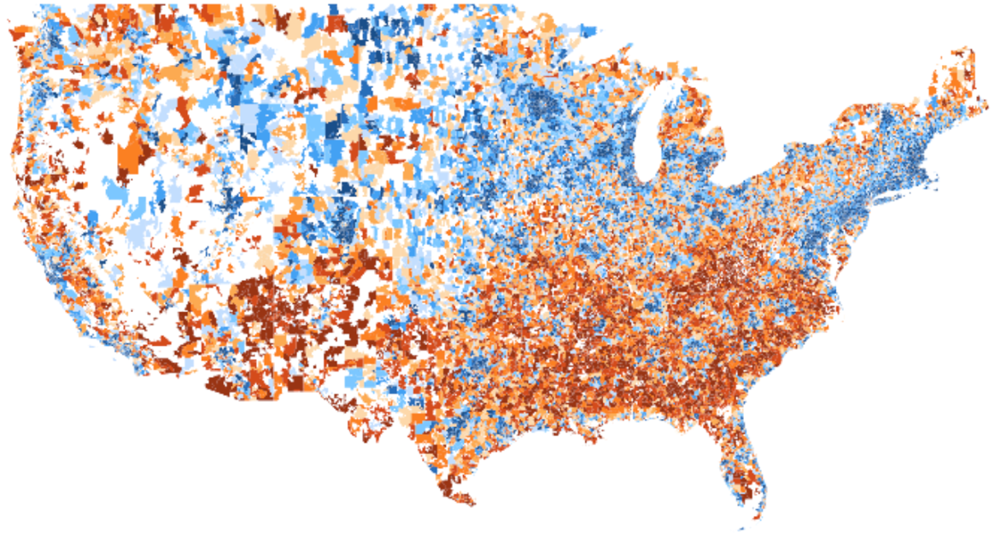

Why Opportunity Zones and Why Now?
52 million Americans (1 in 6) live in economically distressed communities
Prosperous
Distressed
Source: EIG’s “Distressed Communities Index”

Slide 4
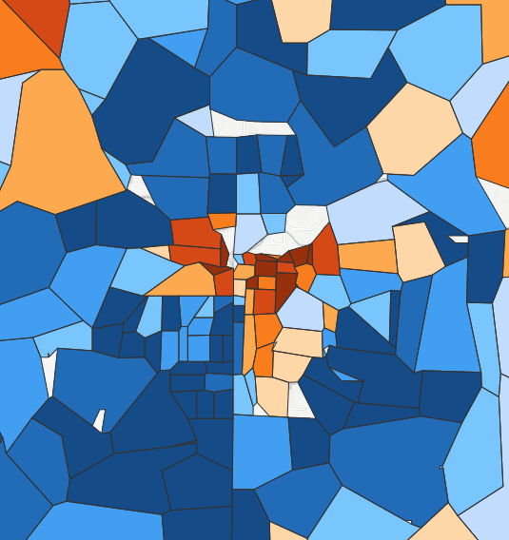
Almost half of all Kansas City residents live in a prosperous zip code…
Nearly
1 million people
live in prosperous
zip codes in the
Kansas City
metropolitan area.
Yet 214,000 people reside in distressed
zip codes right alongside.
Prosperous
Distressed
Source: EIG’s “Distressed Communities Index”

Slide 5

…but growth fails to reach most other communities
Source: EIG’s “Escape Velocity”

Slide 6
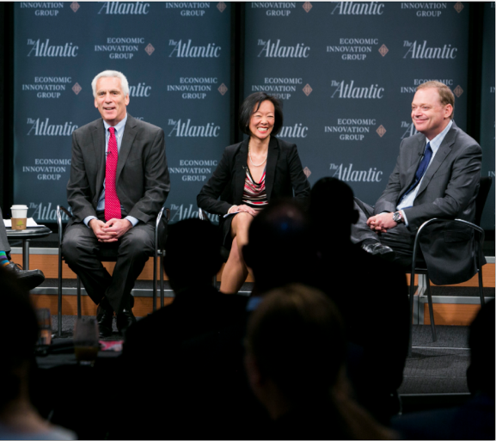
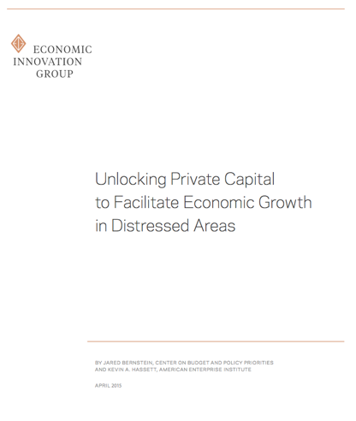
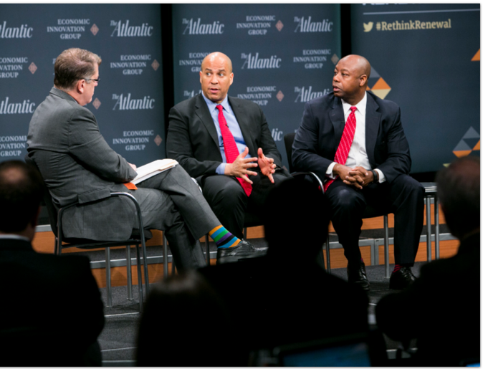
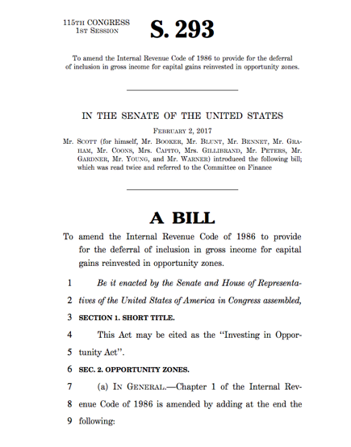
Opportunity Zones are an innovative, flexible, and bipartisan solution for catalyzing private sector-led economic growth
Opportunity Zones were established
by Congress in the Tax Cuts and Jobs
Act of 2017.
The new provision is based on the
bipartisan Investing in Opportunity
Act, which was championed by Senators
Tim Scott (R-SC) and Cory Booker
(D-NJ) and Representatives Pat Tiberi
(R-OH) and Ron Kind (D-WI) and
attracted nearly 100 bipartisan
cosponsors.
EIG originally developed the concept in
a 2015 working paper authored by Jared
Bernstein and Kevin Hassett.

Slide 7

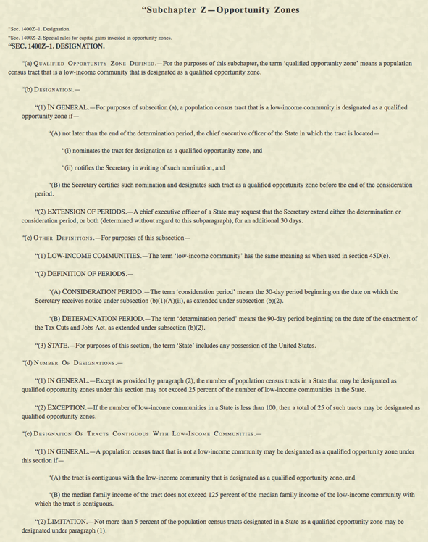
Opportunity Zones aims to connect low-income communities
with much-needed capital
Capital – U.S. households and corporations were sitting on an estimated $6.1 trillion in unrealized capital gains at the end of 2017.
Connect – Opportunity Zones offer a frictionless way for investors to dedicate all or a portion of their winnings to seeding the next generation of enterprise in distressed communities all across the country. In exchange, investors get a graduated series of federal tax incentives tied to long-term holdings.
Source: EIG analysis of the Federal Reserve’s Survey of Consumer Finances
and Financial Accounts of the United States

Slide 8
OZ Benefits
Deferral of Gain
Partial Forgiveness of Deferred Gain
1. 2. 3.
Forgiveness of Additional Gains
Time Value of Deferred Obligation – earlier of:
  Date the investment is sold or exchanged; or
  Outside date of December 31, 2026
Gain Recognition
  Amount of gain (or fair market value)
  Less: the taxpayer’s basis in the opportunity zone fund
Partial Forgiveness of Gain – The Basis Step Up
  5 year hold = 10%
  7 year hold = 15%
Forgiveness of Additional Gain/Investment Appreciation
  10 year hold
  Basis step up

Slide 9
Jan. 2, 2018
Taxpayer enters into a sale generating $1MM of capital gains
June 30, 2018
Taxpayer contributes entire $1MM of capital gain to a Qualified Opportunity Fund
Taxpayer is deemed to have a $0 basis in its QOF investment
QOF Invests the $1MM in Qualified Opportunity Zone Property
2018
2019
2020
2021
2022
2023
2024
2026
2027
2028
2029

Slide 10
Jan. 1, 2018
Taxpayer enters into a sale that generates $1M of capital gain
June 30, 2023
Taxpayer’s basis in investment in QOF increases from $0 to $100k
June 30, 2025
Taxpayer’s basis in investment in QOF increases from $100k to $150k
Dec. 31, 2026
$850K of the $1MM of deferred capital gains are taxed; basis in QOF investment increases to $1MM.
June 30, 2018
(Within 180 days), Taxpayer contributes entire $1M of capital gain to a Qualified Opportunity Fund
2018
2019
2020
2021
2022
2023
2024
2025
2026
2027
2028

Slide 11
Qualified Opportunity Funds
An Investment Intermediary
  Must be organized as a Corporation or Partnership
  Purpose – to invest in OZs
  Assets Test – Must hold at least 90% of assets in (1) stock or partnership interests of a Qualified Opportunity Zone Business, and/or (2) Qualified Opportunity Zone Business Property
Certification
  Statute authorizes fund certification by Treasury
  Treasury announced Funds will “self-certify” by filing a form with their tax return
  No limit on the number of Funds that can be created

Slide 12
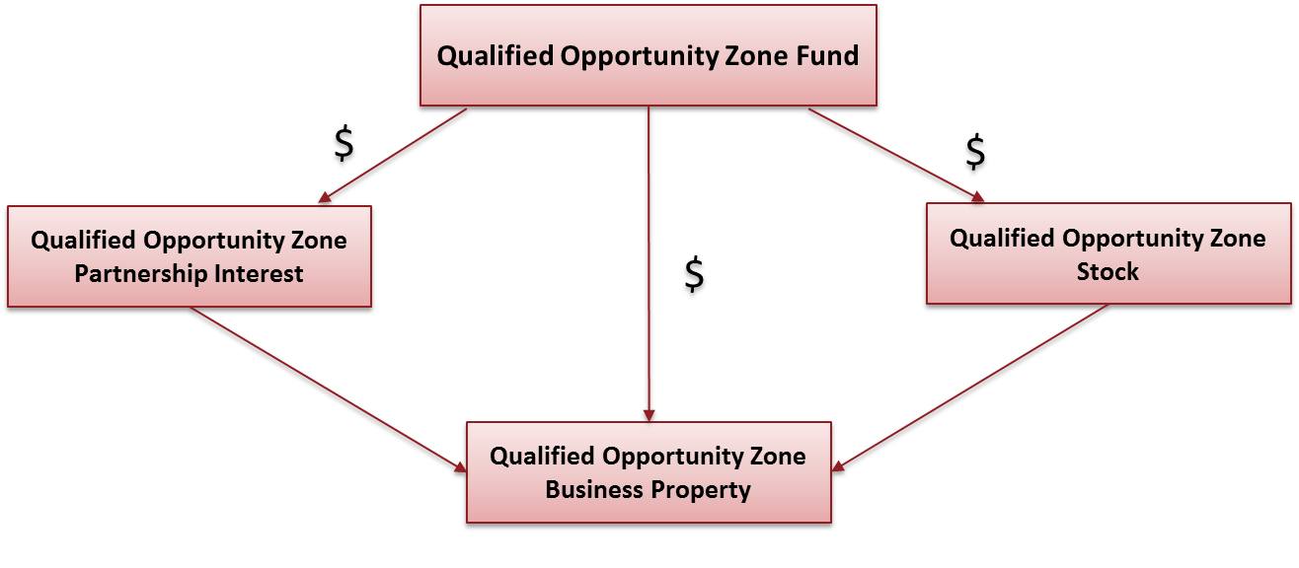
Investments in Qualified Opportunity Zone Property

Slide 13
Issues to Consider and Restrictions
“New” Property – must be acquired by purchase from an unrelated party (20% standard) after December 31, 2017
Active Conduct – At least 50% of income derived from Active Conduct
No more than 5% of the asset base of the opportunity zone business can be “nonqualified financial property”
Prohibition on “Sin Businesses”
Original use or substantial rehab – either:
  Original use of the of the property within an OZ commences with the opportunity zone business; or
  The opportunity zone business substantially improves the property

Slide 14
OZ Incremental Benefit
23.8% Tax Rate | 4 Year | 5 Year | 7 Year | 12/31/2026 | 10 Year
Standard After Tax IRR | 6.00% | 6.00% | 6.00% | 6.00% | 6.00%
Incremental OZ Benefit | 1.44% | 2.08% | 1.95% | 1.71% | 3.08%
OZ Investment IRR | 7.44% | 8.08% | 7.95% | 7.71% | 9.08%
Percentage Increase | 24% | 35% | 32% | 29% | 51%
*Table Source-Novogradac & Company (www.novoco.com/resource-centers/opportunity-zones-resource-center)

Slide 15
Section 1031 vs Opportunity Zones
Comparison of Section 1031 & Opportunity Zone Fund
 | Section 1031 | Opportunity Zone Fund
Eligible asset classes | Only real assets held for productive use | Any
Where can you invest? | Anywhere | Limited
What needs to be invested? | All Proceeds | Only Capital Gains in any amount
Investment Timing | Within 180 Days | Within 180 Days
Intermediary Required? | Yes | No
Tax Benefits | Can delay tax indefinitely, but capital gains are fully taxable at the time of sale of new property Heirs get set up in basis to the market value, but can eliminate tax up to the estate tax exemption | OZ reinvestments receive a 10% increase in base after 5 years, and 15% after 7 years Capital gains tax are deferred until December 31, 2026 Zero capital gains tax after 10 years

Slide 16
Several key characteristics of the provision explain rising excitement
It is flexible: The structure is specifically designed to fit the many different investment needs of struggling communities
It is scalable: There is no appropriated cap on how much capital it can move
It is simple and avoids the micromanagement of business models
It unlocks scarce equity capital
It is market-oriented and lets investors move at the speed of business
It rewards successful investments in the future, rather than providing a subsidy up-front. This shifts the burden of risk from taxpayers to investors
The fund model allows for broad participation
It can provide an anchor for local economic development strategies

Slide 17
Readily Identifiable Investment Types in Opportunity Zones
Commercial Real Estate Development and Renovation in Opportunity Zones
Opening New Businesses in Opportunity Zones
Expansion of Existing Businesses into Opportunity Zones
Large Expansions of Businesses already within Opportunity Zones

Slide 18
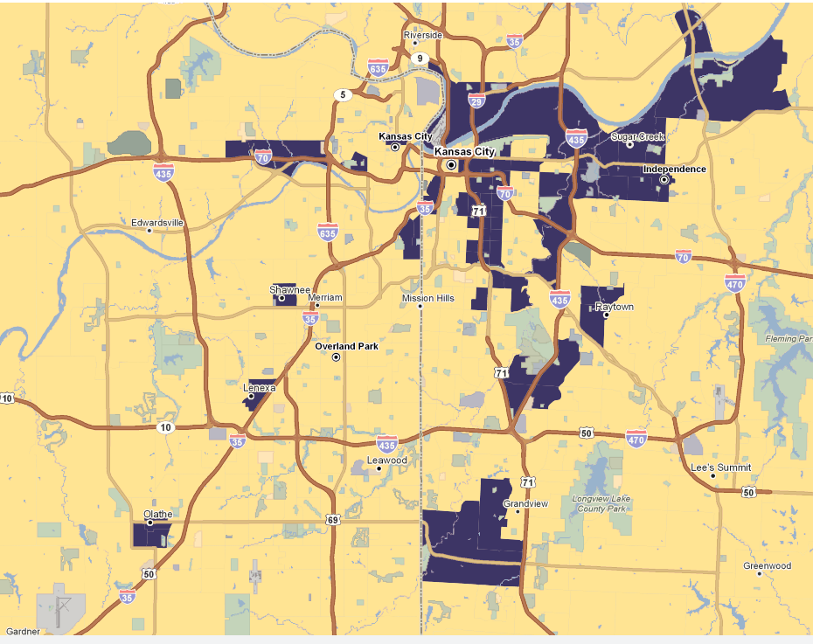
Opportunity Zone Mapping
Kansas City

